Slide 1
Pragmatics (1)
Lecture 9

Slide 2
Speech act
Language conveys specific meanings/information.
John was born in 2000.
Jelly wears a face mask.
Joe majors in computer science.
Language also performs specific acts.
I apologize.
I name the baby Jack.
I pronounce you man and wife.
Asking questions, making requests, giving orders, making promises, giving advice, making threats, …

Slide 3
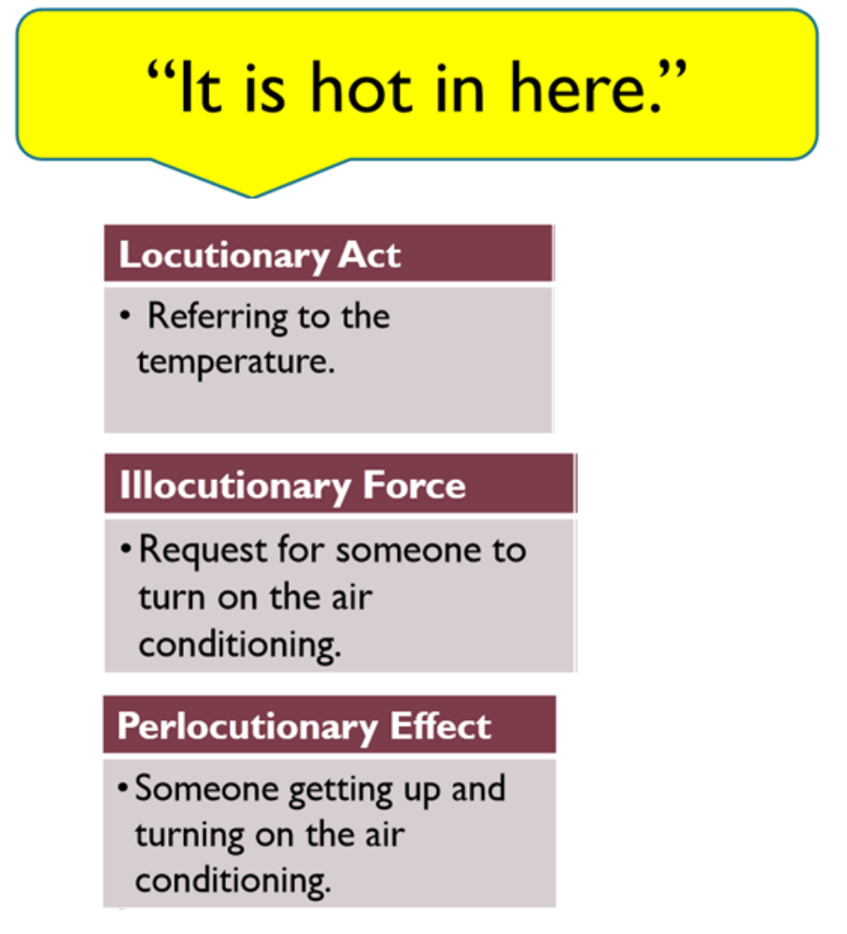
Three facets of a speech act
Actually, the act a speaker performs while speaking is reflected in different facets/levels.
1. Locutionary act: the act of speaking (the actual words uttered)
2. Illocutionary act: the action intended to be performed by a speaker (the force or intention behind the words)
3. Perlocutionary act: the bringing about of consequences or effects on the hearer (the effect of the illocution on the hearer)

Slide 4
Three facets of a speech act
Relations among the three facets of speech act
The same locutionary act can have different illocutionary forces in different contexts.
The same illocutionary force can be realized by means of different locutionary acts.

Slide 5
Three facets of a speech act
Identify the three facets of the following speech act.
Somebody tells you: Kiss her !
Locutionary act:
Illocutionary act:
Perlocutionary act:

Slide 6
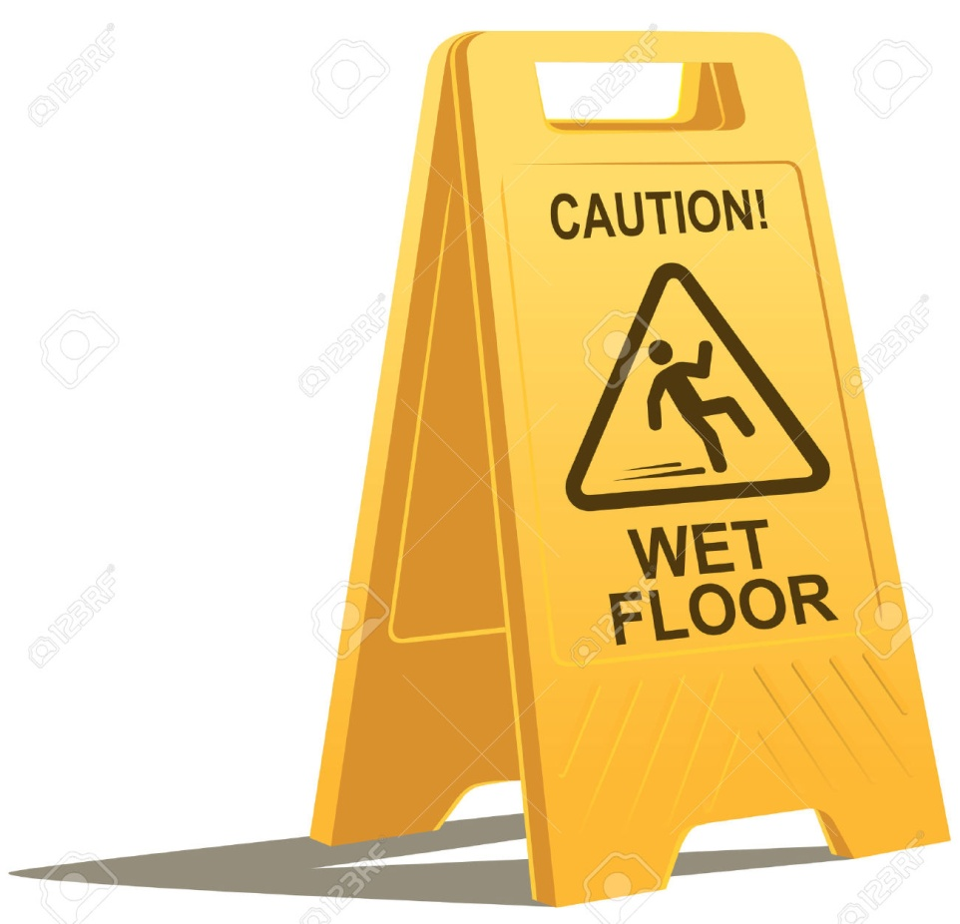
Three facets of a speech act
Identify the three facets of speech act implied in the following sentence.
Locutionary act:
Illocutionary act:
Perlocutionary act:

Slide 7
Speech act
The term “speech act” is generally interpreted quite narrowly to mean only the illocutionary force of an utterance.
What types of speech acts can speakers perform?

Slide 8
Categories of Illocutionary Acts
1. Assertives/representatives – acts that commit the speaker to something’s being the case (expressing the speaker’s belief)
– stating, informing, predicting, confirming, denying, concluding, …
stating a fact or an opinion
Anything boys can do girls can do better.
The weather will be cold tomorrow.
confirming or denying something
It’s not true that girls are academically inferior to boys.
making a prediction
The number of people living in cities will likely triple by 2050.

Slide 9
Categories of Illocutionary Acts
2. Directives – acts that get the listener to do something (expressing the speaker’s desire/wish for the listener to do something)
– Requesting, ordering, forbidding, advising, suggesting, insisting, recommending, warning, inviting, asking, …
Making a request
Could I use your phone, please?
making an invitation
Can we do lunch sometime next week?
issuing an order
Get out of my face!
giving advice or permission
You had better prepare for the mid-term in advance.

Slide 10
Categories of Illocutionary Acts
3. Commissives – acts that commit the speaker to future course of action
– promising, threatening, volunteering, offering, guaranteeing, refusals, planning, opposing, …
Making a promise
I’ll join you at the country club.
Making threats
If you cross that line, I'll shoot you!

Slide 11
Categories of Illocutionary Acts
4. Expressives – acts that share psychological attitude or state of the speaker about something
– apologising, thanking, congratulating, condoling, welcoming, …
– statements of pleasure, pain, likes, dislikes, sorrow, …
Offering thanks
Thank you all for being here tonight on this very special occasion.
Expressing feelings
I’m really sorry.
Expressing congratulations
Congratulations!

Slide 12
Categories of Illocutionary Acts
5. Declarations/declaratives – acts that change the state of some entities/affairs
– naming, appointing, resigning, firing, marrying, divorcing, baptizing
naming a ship
I name this ship Titanic.
baptizing a child
I baptize this child James.
Priest: I now pronounce you man and wife.
Referee: You‟re out!

Slide 13
Categories of Illocutionary Acts
One utterance may express more than one illocutionary act at one time.
Bus driver:
This bus won’t move until you boys move in out of the doorway.
Assertive: ?
Directive:?

Slide 14
Direct and indirect speech acts
Direct speech act:
performing one speech act by means of performing that speech act
I'm hungry.
Stand up!
Indirect speech act:
performing one speech act by means of performing another speech act
I'm hungry.
Can you stand up?

Slide 15
Direct and indirect speech acts
Three sentence types:
1. Declarative sentences
a. The dog ate the bone.
b. John slept until 11 and missed his first two classes.
2. Interrogative sentences
a. Is it raining today?
b. How many times have you been to Cleveland?
3. Imperative sentences
a. Go to the end of the line.
b. Don't even think of trying to cheat on this test.
c. Tell me what happened.

Slide 16
Direct and indirect speech acts
Certain sentence types are usually used to perform certain acts in communication.
direct speech act: direct match between a structure and a function
-- Can you ride a bicycle? -- I request you to open the window.
-- I promise I’ll help you. -- I apologize. -- I name this ship Titanic.
indirect speech act: indirect match between a structure and a function
-- Can you pass the salt?
-- It is hot in here.
Structure (sentence types) | Function (illcutionary acts )
Declarative | Assertives, Explicit form of Directives, Commissives, Expressives, Declaration
Interrogative | Questions
Imperative | Directives

Slide 17
Direct and indirect speech acts
An utterance might serve as a direct speech act as well as an indirect speech act.
-- It’s cold outside.
Direct speech act: ?
Indirect speech act: ?

Slide 18
Direct and indirect speech acts
In indirect speech acts, what is said by the speaker is NOT what is actually meant by the speaker.
A failure to recognize this would make communication weird!
A: Excuse me. Do you know where the Ambassador Hotel is?
B: Oh sure, I know where it is. (and walks away)

